Slide 1


Access the interactive report at: indicators.sciphil.org
Notes:
Updated July 2026

Slide 2


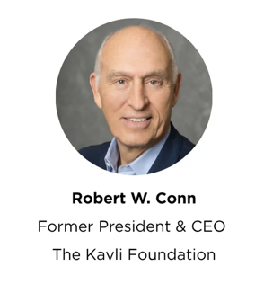


A Collaboration between the Science Philanthropy Alliance and
the UC San Diego Frontiers in Science & Innovation Program
President
Explorative Science Foundation
Strategy Director
Science Philanthropy Alliance
Former President and CEO
The Kavli Foundation
President
Science Philanthropy Alliance

Slide 3
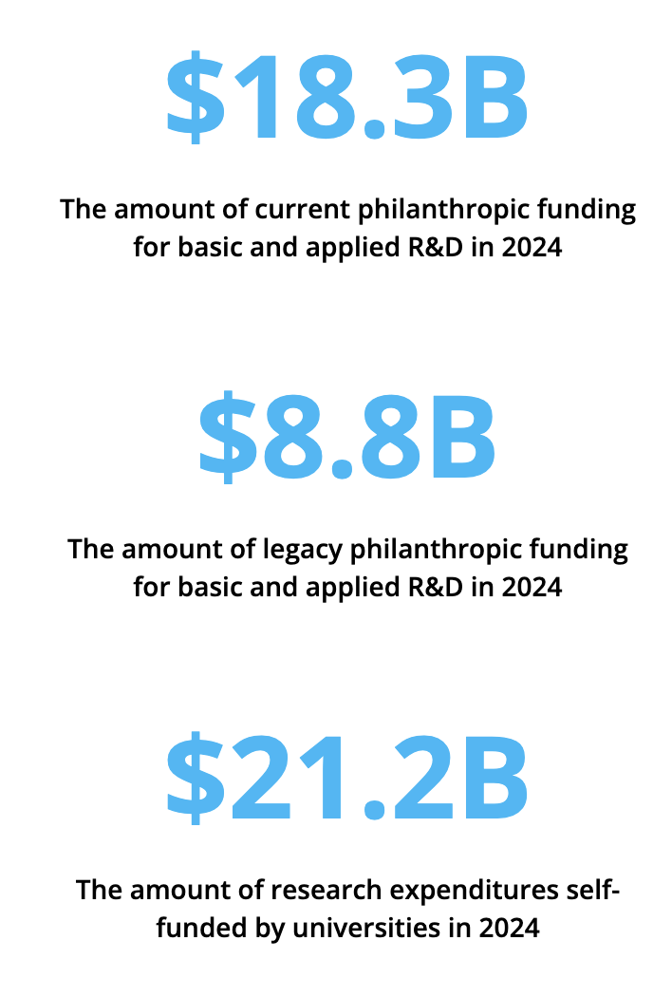
Key Findings
The federal government is the largest research funder at universities and nonprofits, totaling $63.6B (50%) in 2024.
Estimated philanthropic support for R&D expenditures is $27.0B (21%), with $18.3B in current and $8.8B in legacy philanthropy.
Universities self-funded an additional $21.2B (17%) through other non-philanthropic revenue sources.
We project federal funding at universities and nonprofits to be $59.9B in 2025 and $60.4B in 2026. If the 2027 President’s Budget were enacted, federal funding would further drop by 23%.

Slide 4
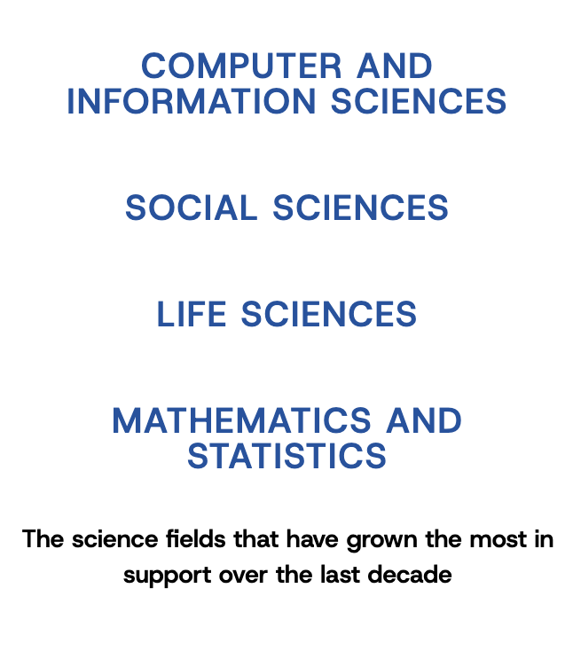
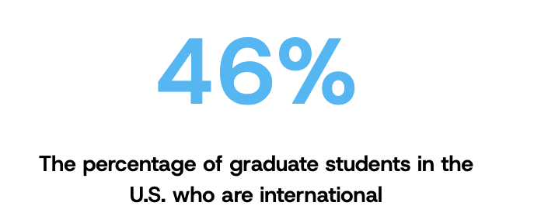
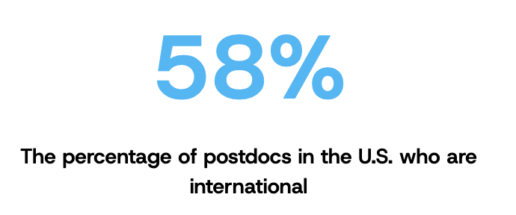
Key Findings
Most science R&D expenditures (74%) at universities are for the life sciences, totaling $66.8B in 2024.
An additional $19.3B is for engineering R&D at universities.
The fields that have grown the most are computer sciences, life sciences, social sciences, and mathematics and statistics.
The federal government supports 25% of doctoral students and nearly 50% of postdocs in science and engineering.
Across all science and engineering fields, 46% of graduate students and 58% of postdocs in the U.S. are international.

Slide 5
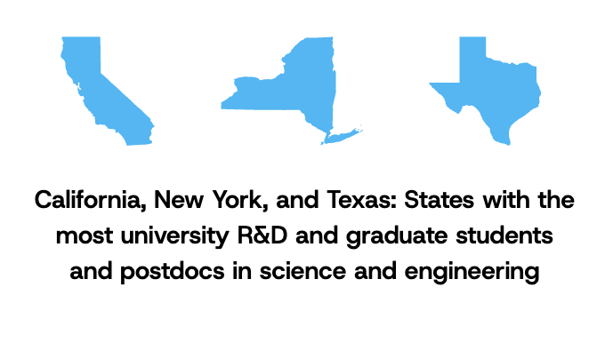
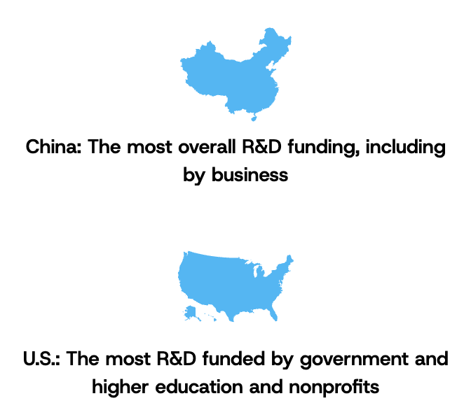
Key Findings
California, New York, and Texas have the most university R&D and graduate students and postdocs in science & engineering.
China surpassed the U.S. in 2024 in terms of the most R&D expenditures (adjusted for purchasing power parity).
The U.S. ranks first in terms of R&D performed by the higher education sector and R&D funded by government and by higher education and nonprofits, which includes philanthropy.
Switzerland has the most basic research expenditures as a percentage of GDP, followed by Korea, Austria, and Denmark.

Slide 6


R&D Overview

Slide 7
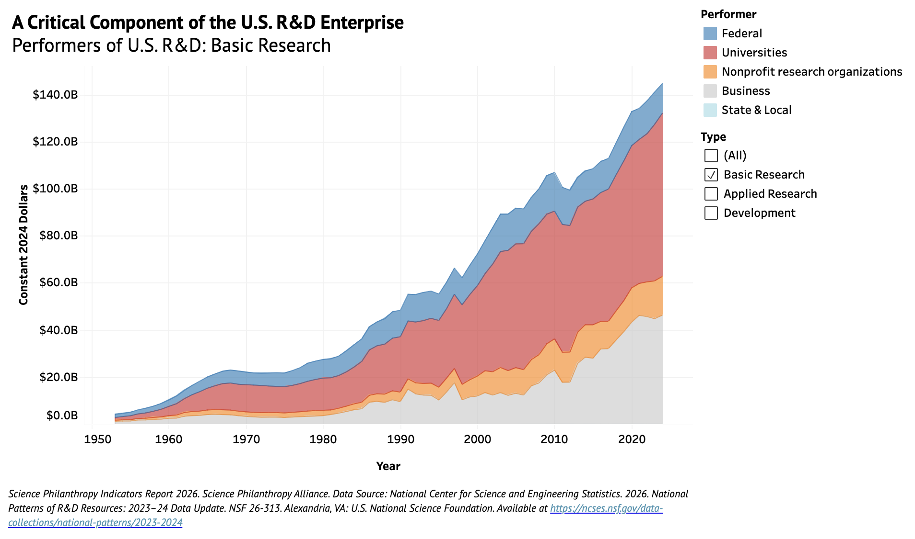

Slide 8
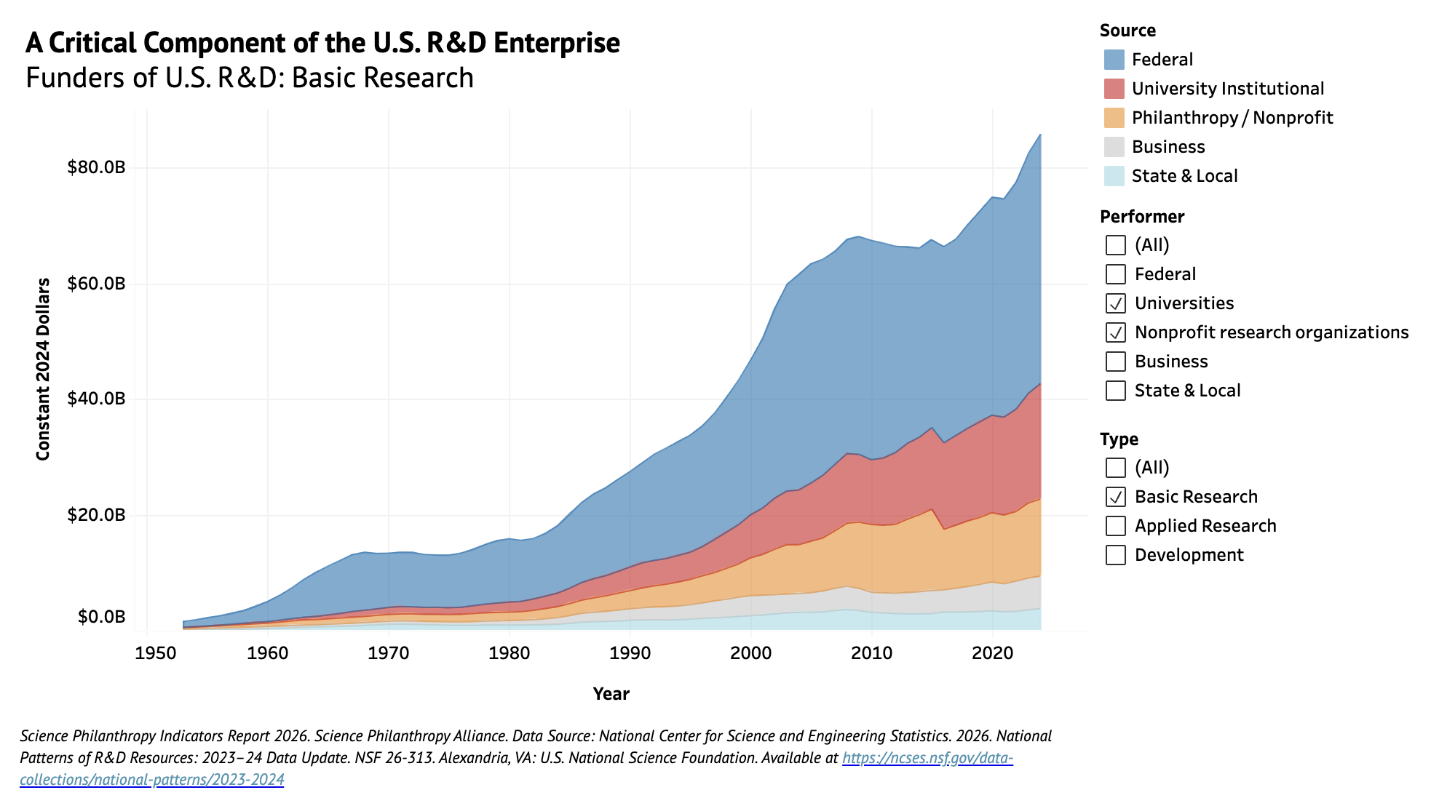

Slide 9
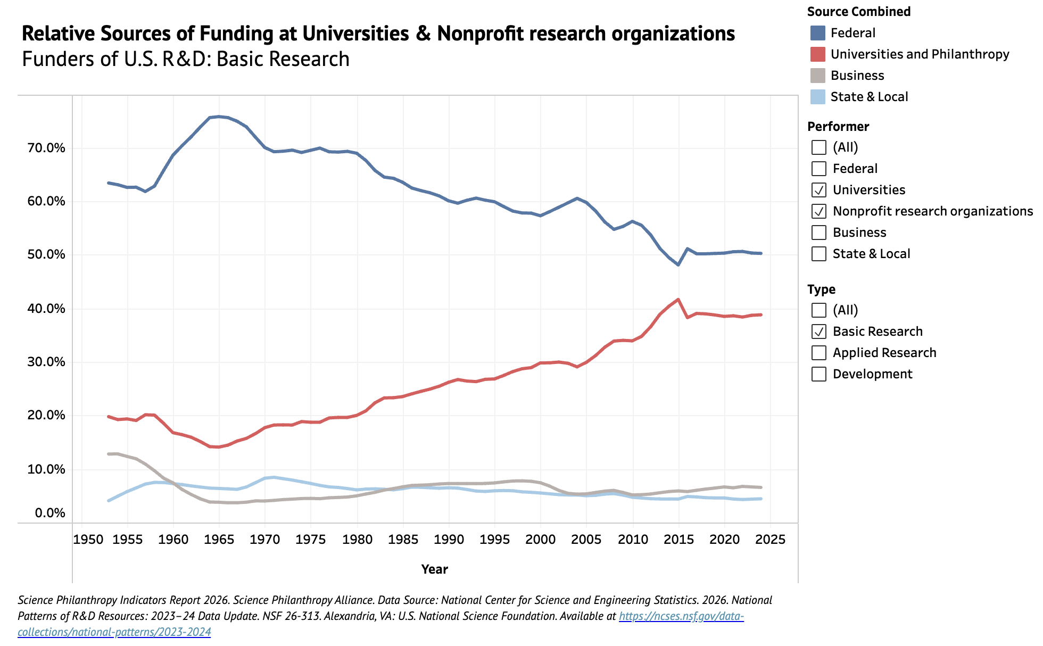

Slide 10
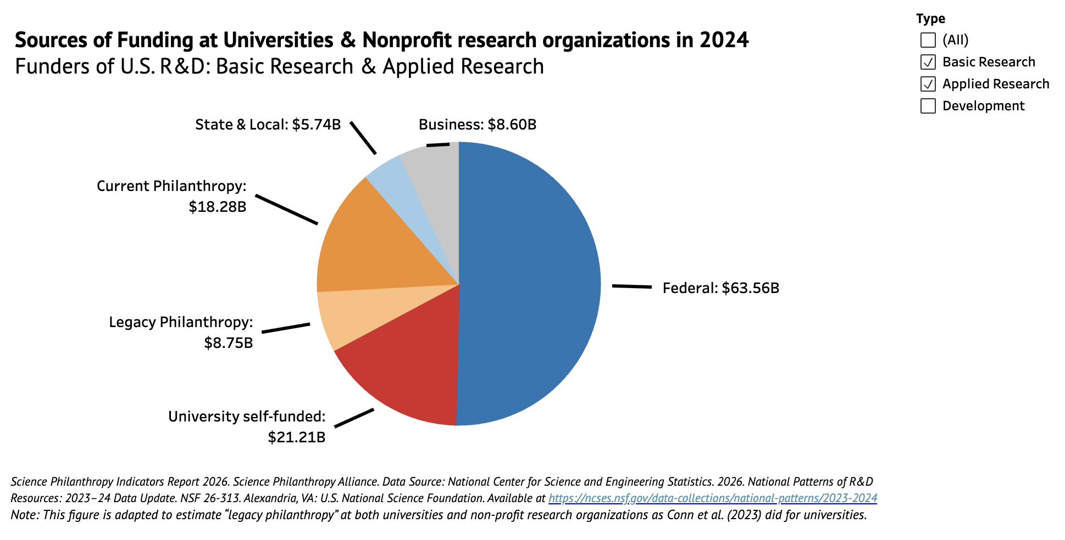

Slide 11
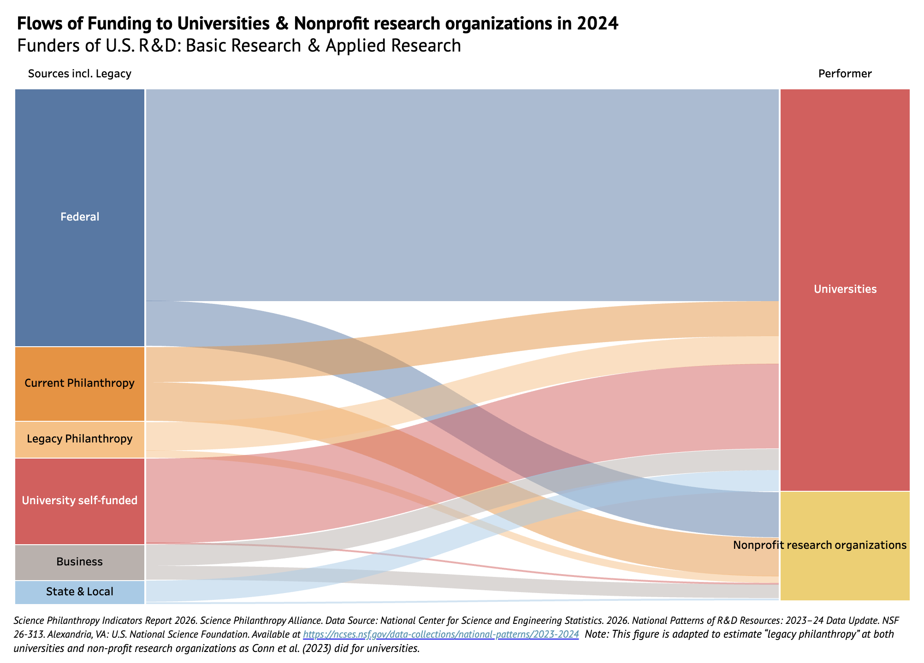

Slide 12
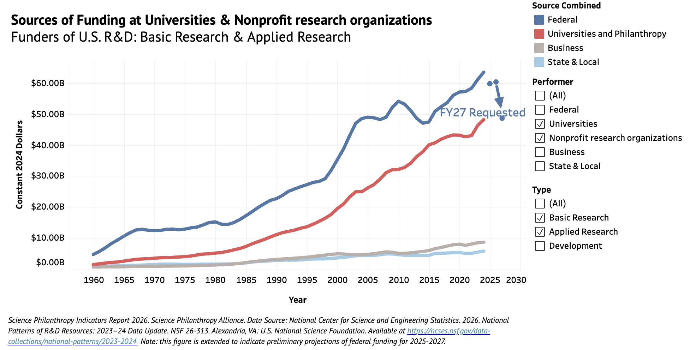

Slide 13
R&D By Field

Slide 14
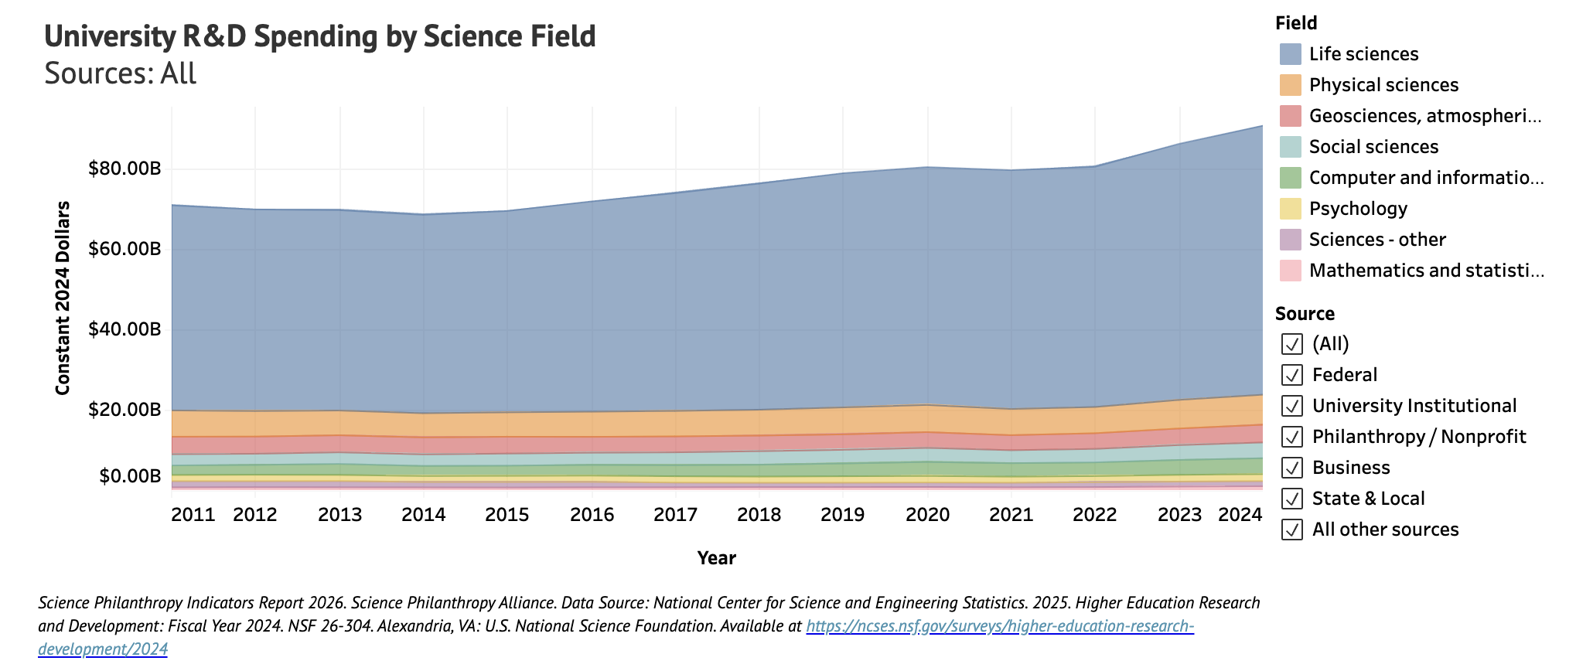

Slide 15
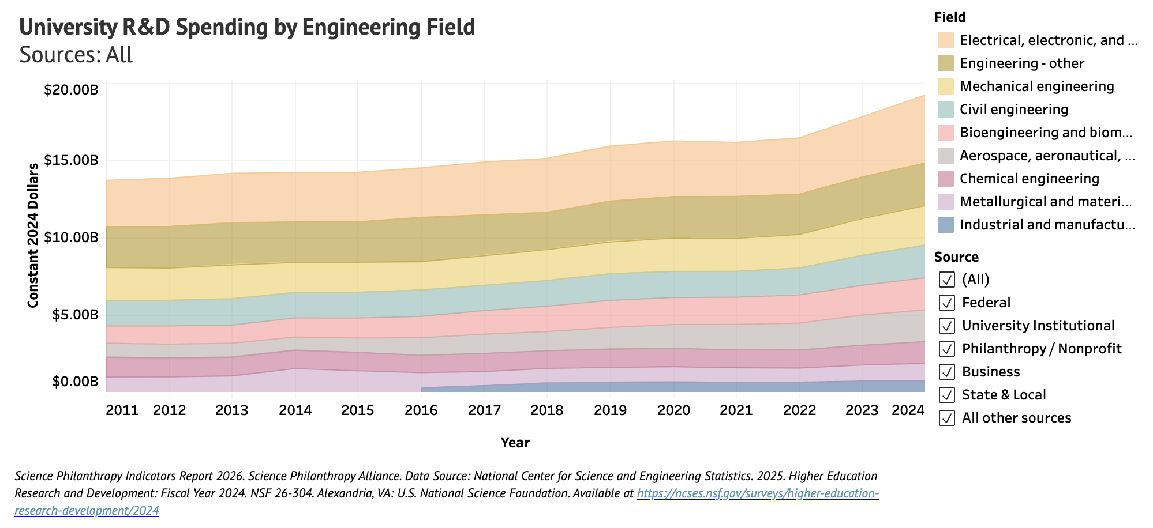

Slide 16
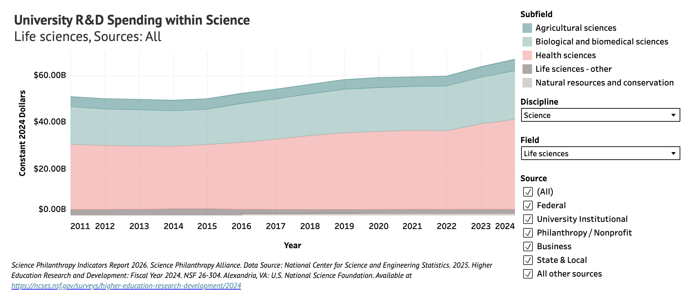

Slide 17
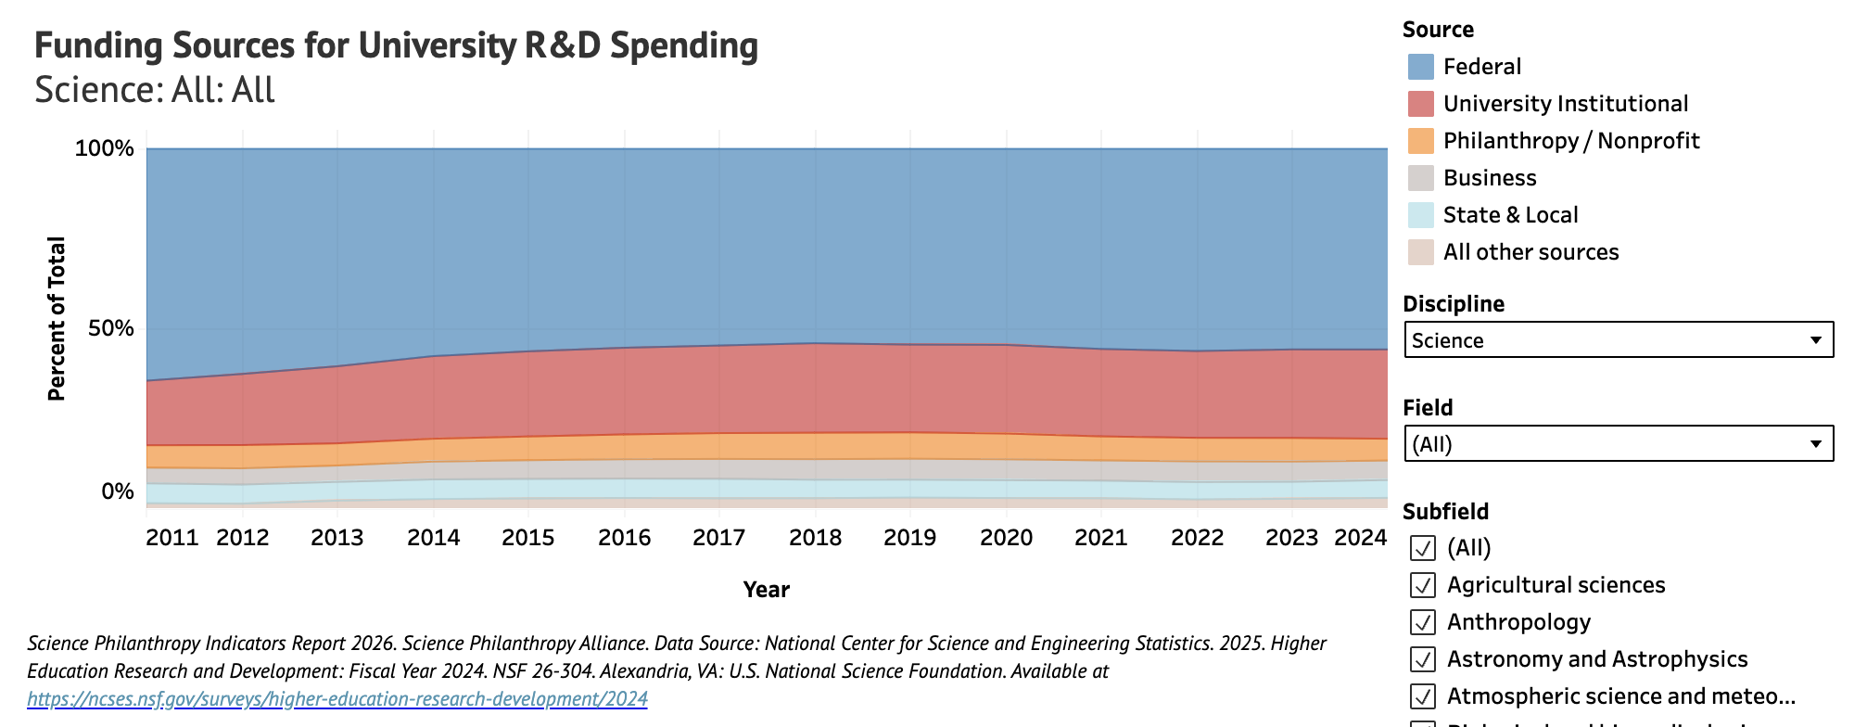
Notes:
You can also look at the funding sources for university R&D in each field and subfield. In this case, we are looking at all sciences.
More than half (56%) of all university R&D on science is supported by the federal government.
A quarter (25%) are supported by university institutional funds (which are to some extent philanthropic in origin via legacy philanthropy).
And a smaller portion – about 6% - from philanthropic and nonprofit funding sources.
University and nonprofit sources going up slightly over the last decade.
On the interactive site, you can use the options on the right to look at individual fields and subfields.

Slide 18
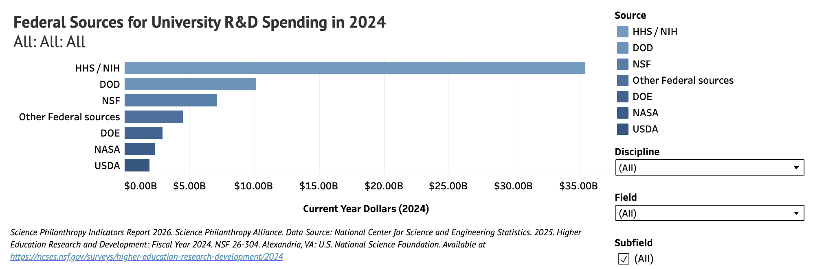

Slide 19
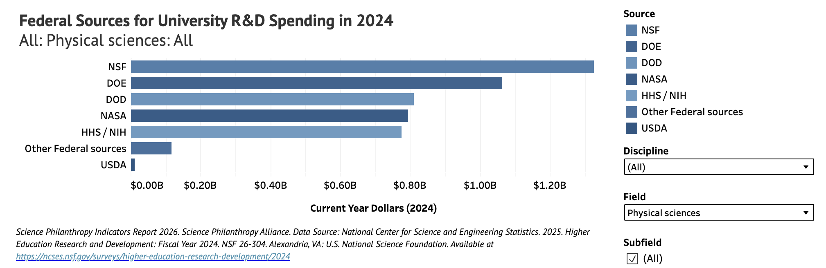

Slide 20
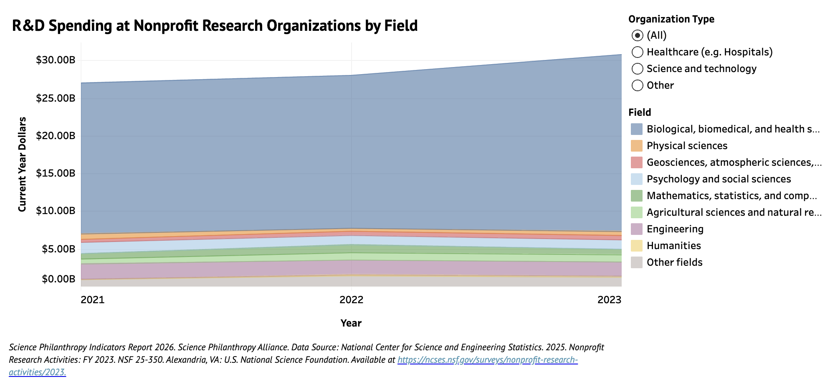

Slide 21
Graduate Students and Postdocs

Slide 22
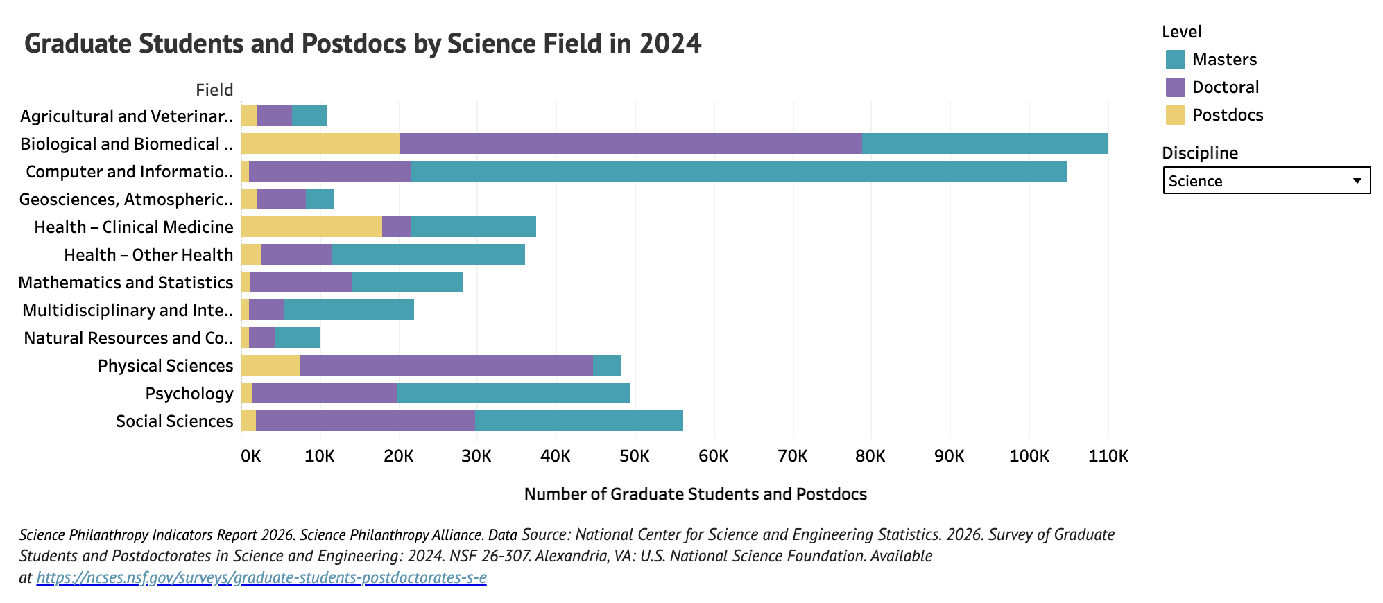

Slide 23
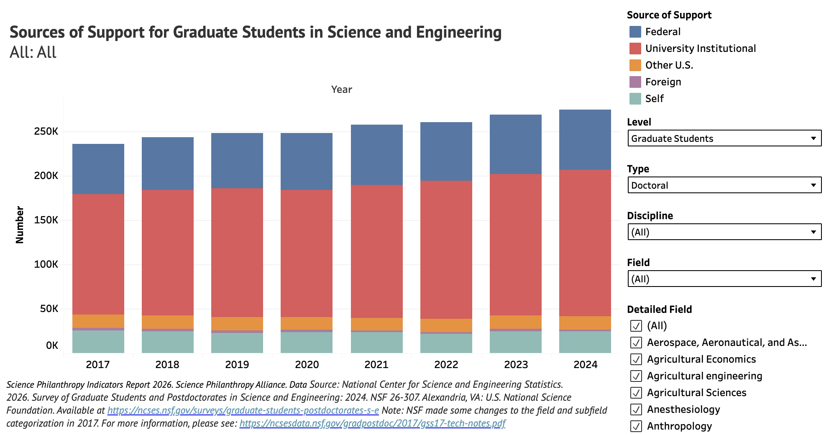

Slide 24
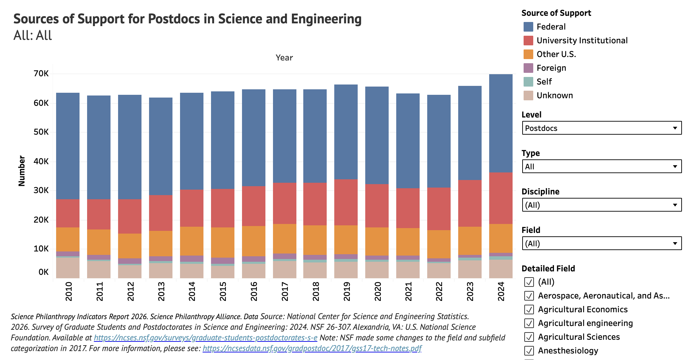

Slide 25
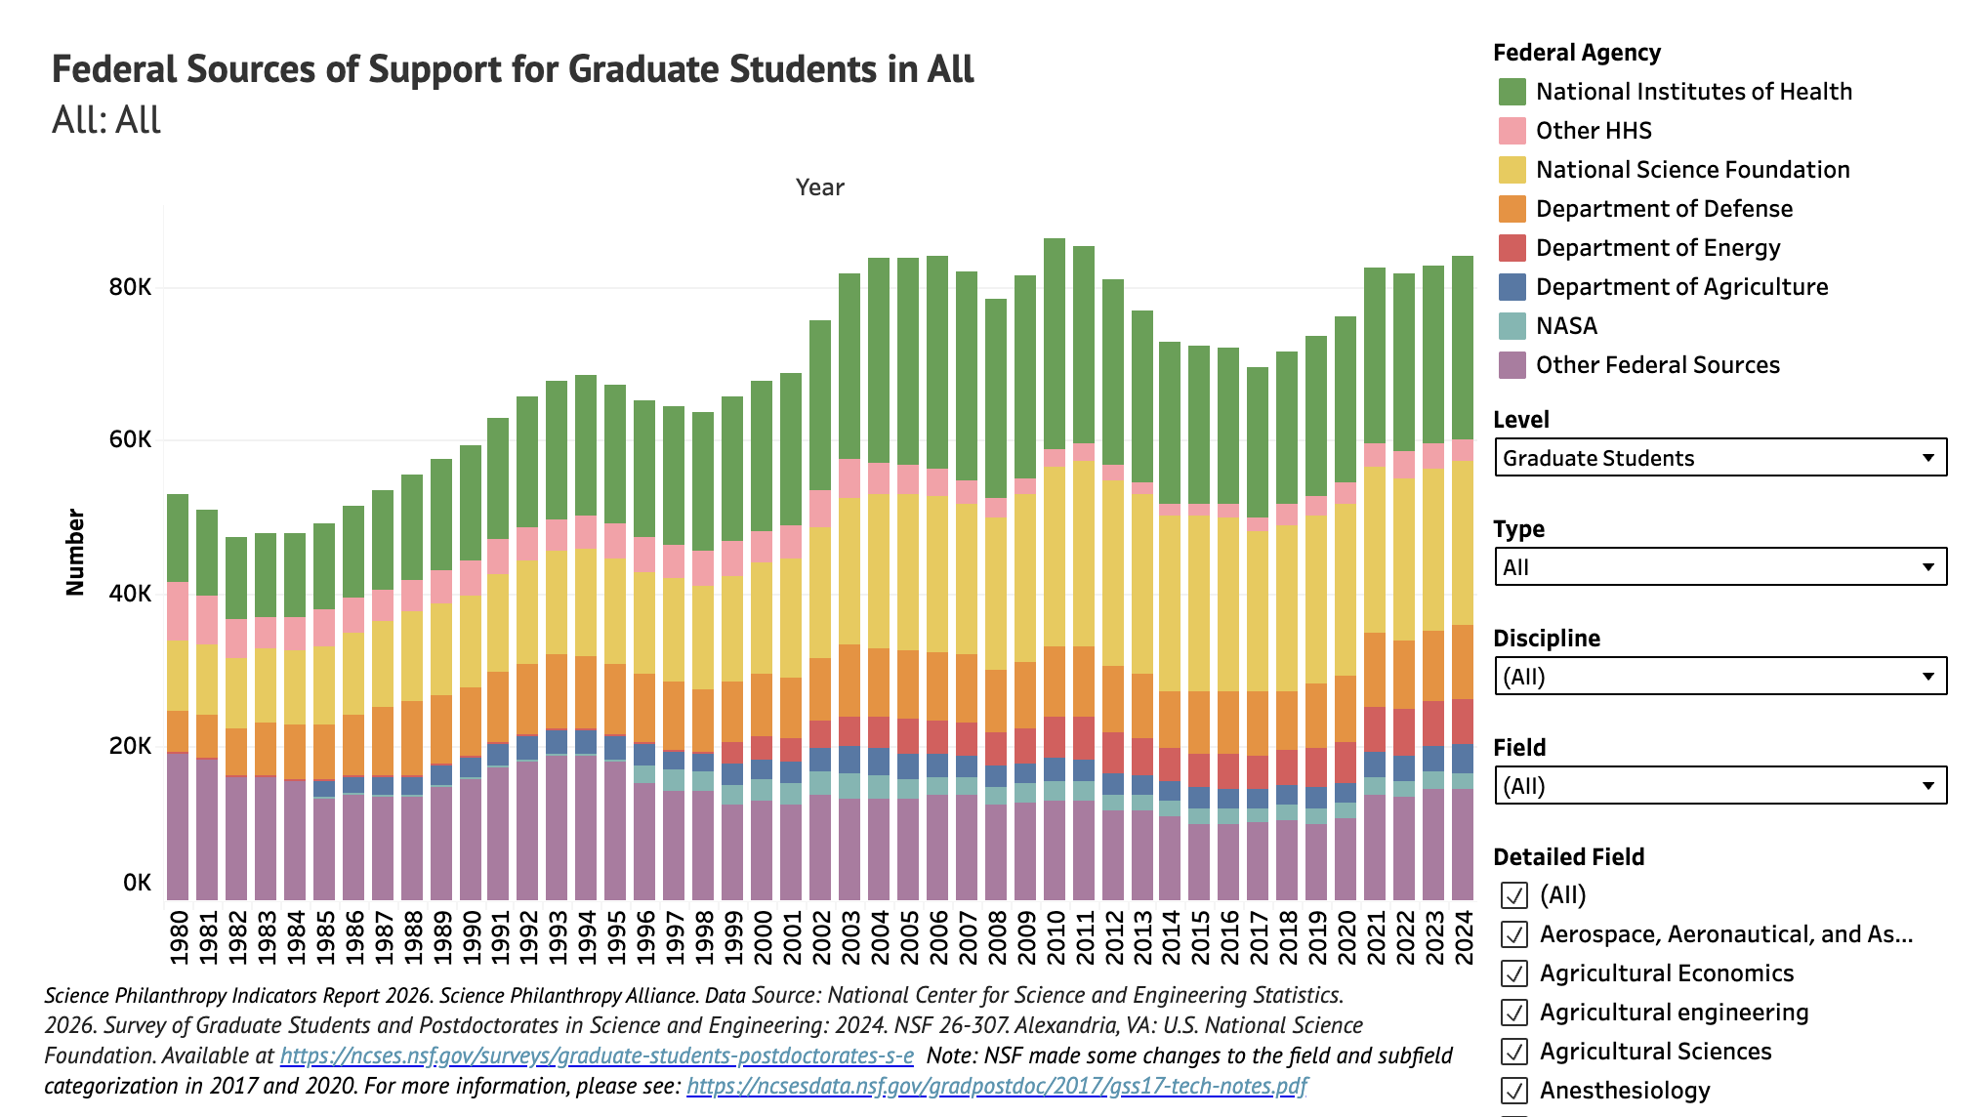
Science and Engineering: All: All
All Science and Engineering

Slide 26
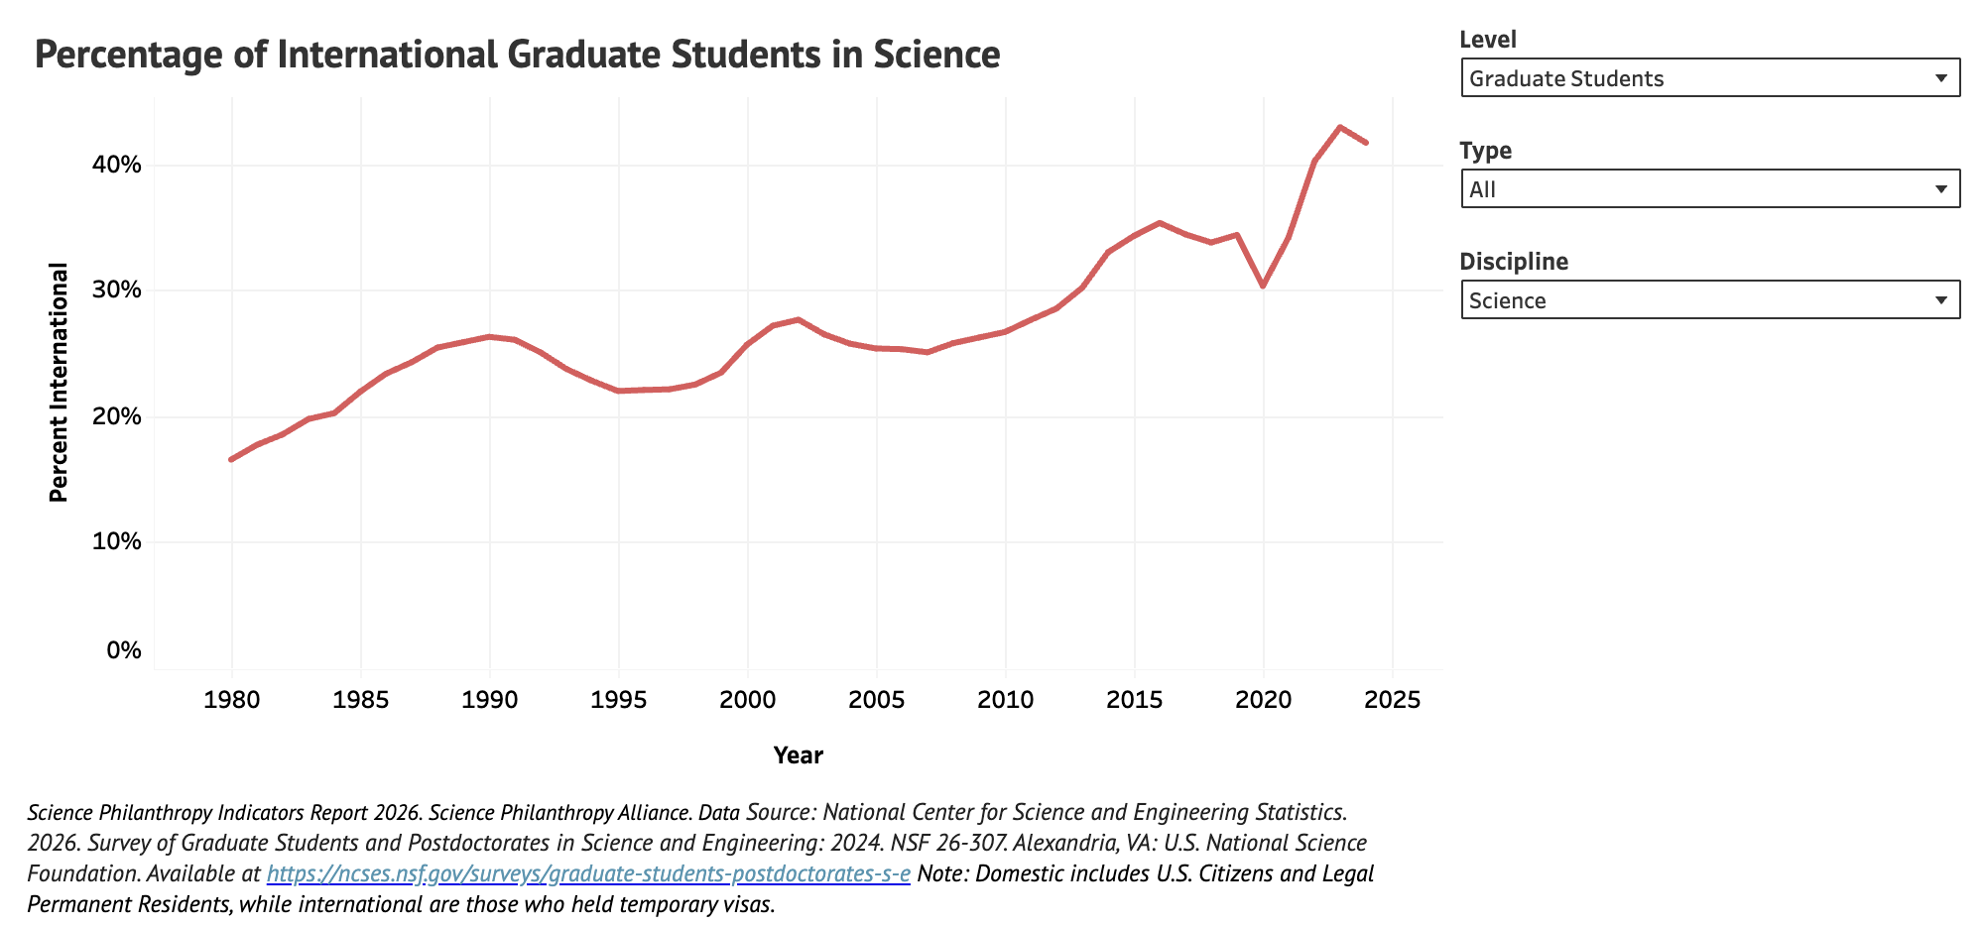
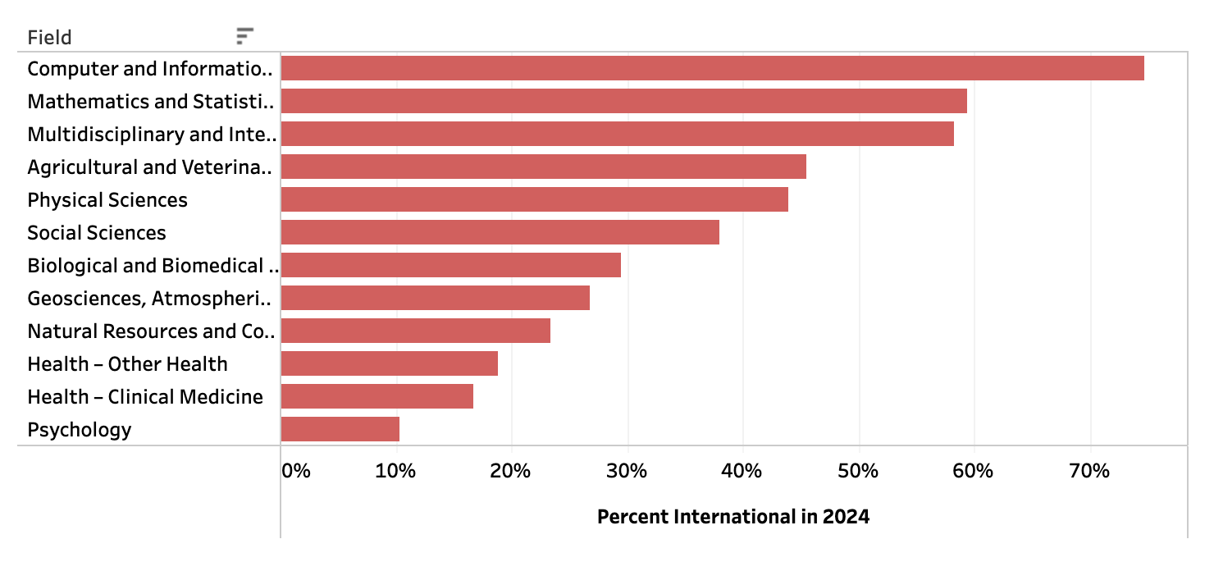

Slide 27
By Institution

Slide 28
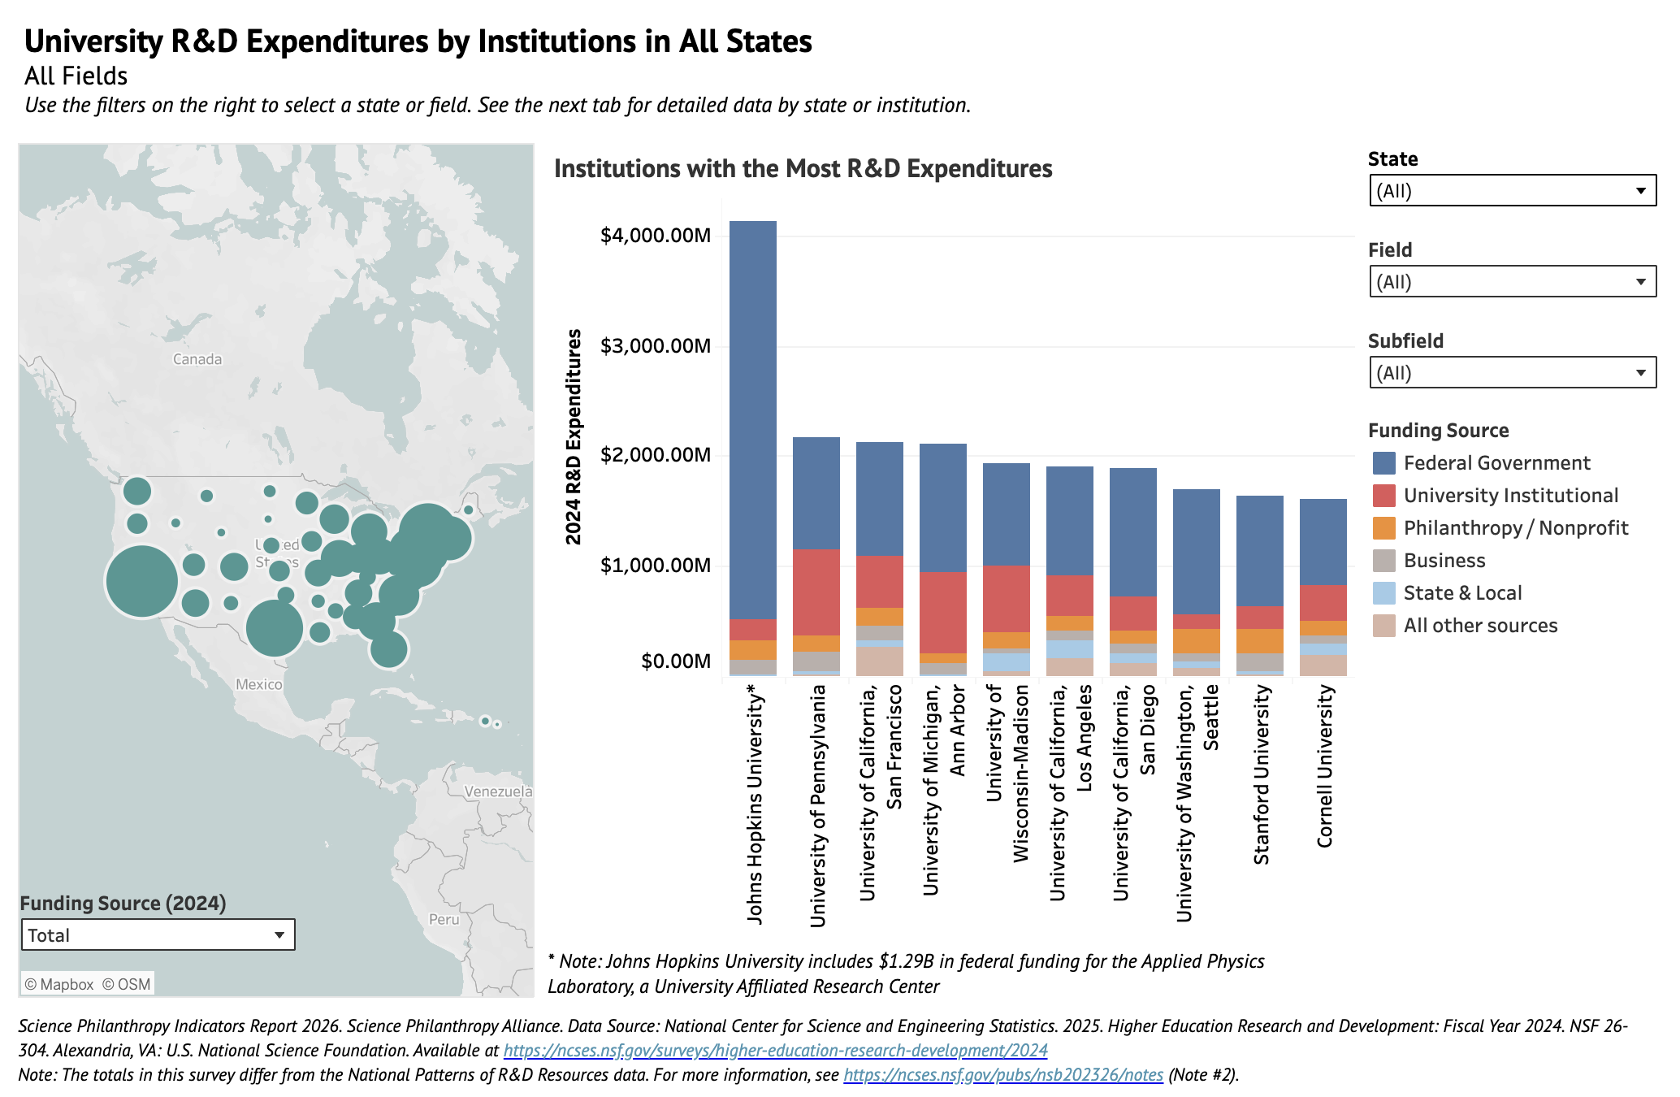

Slide 29
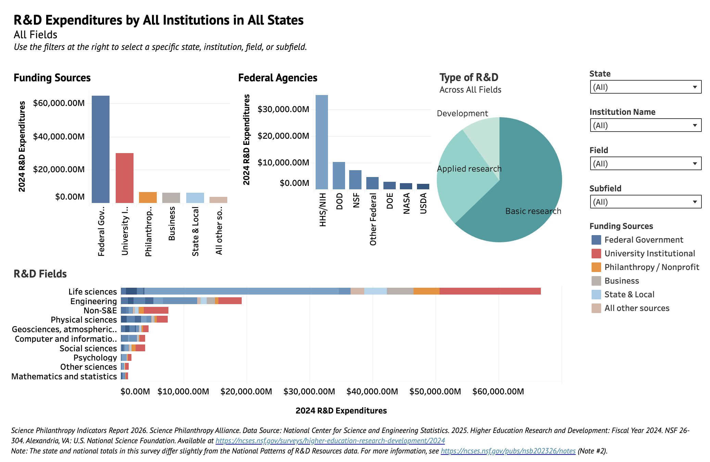

Slide 30
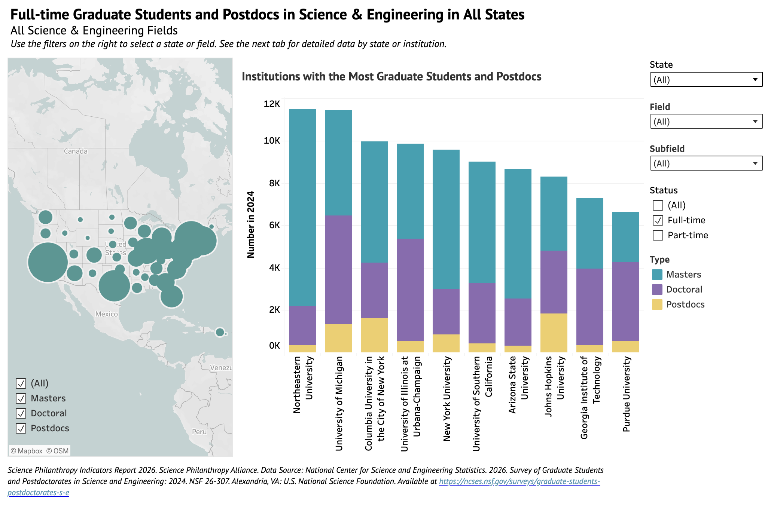

Slide 31
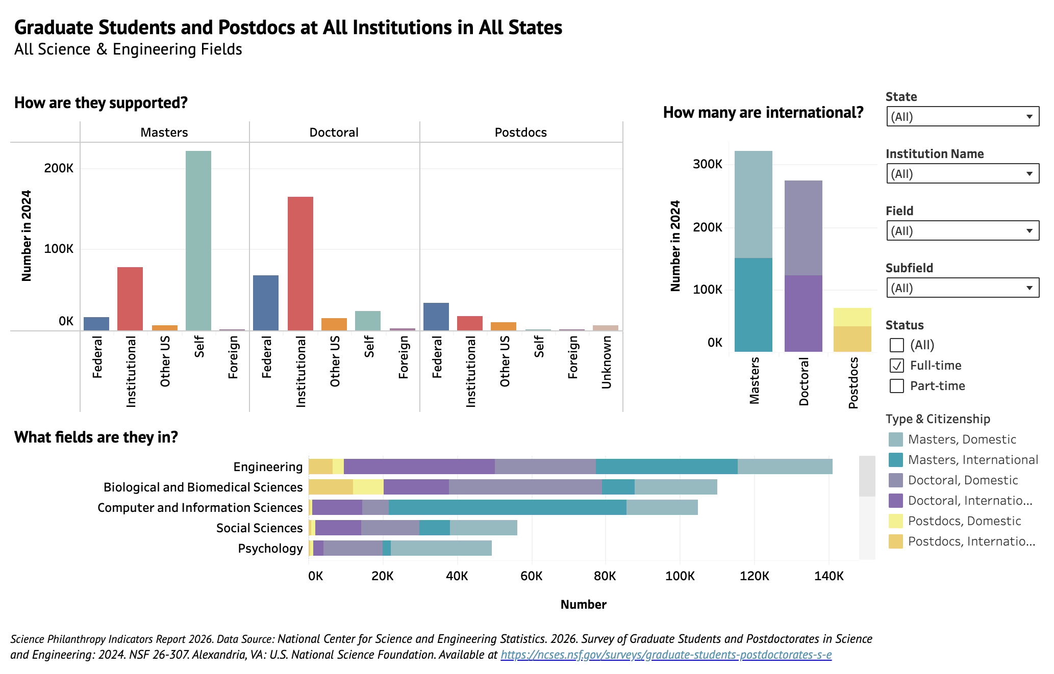

Slide 32
Global R&D

Slide 33
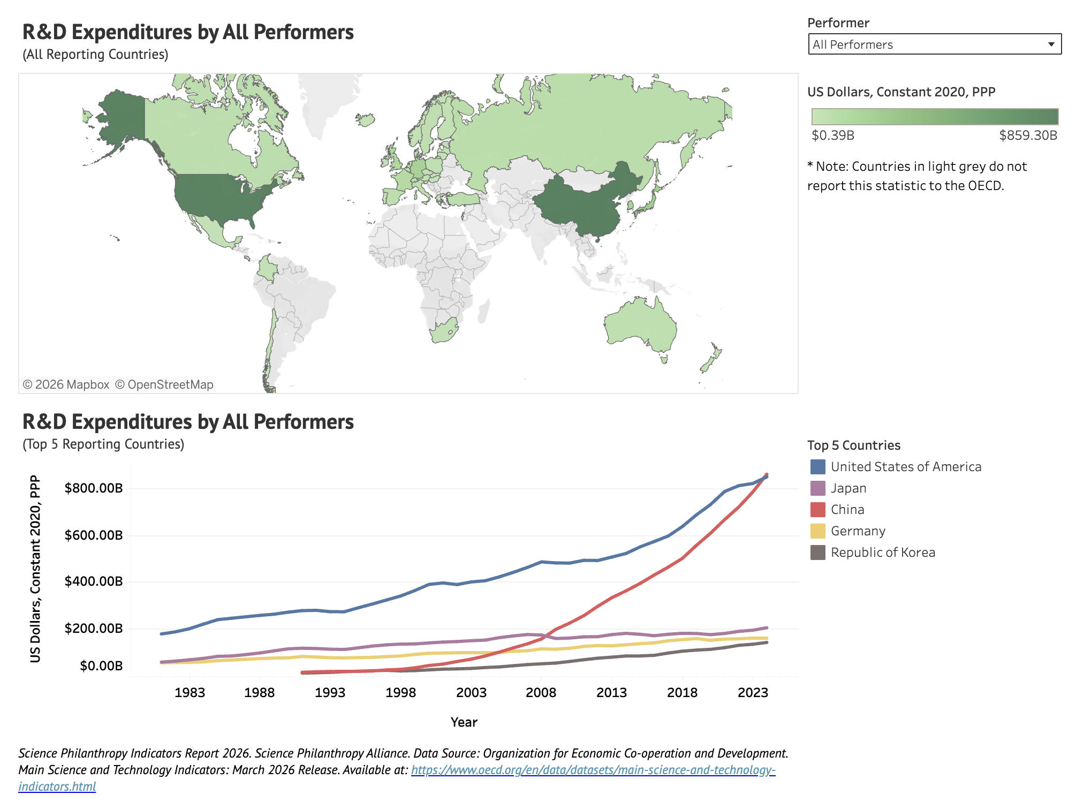

Slide 34
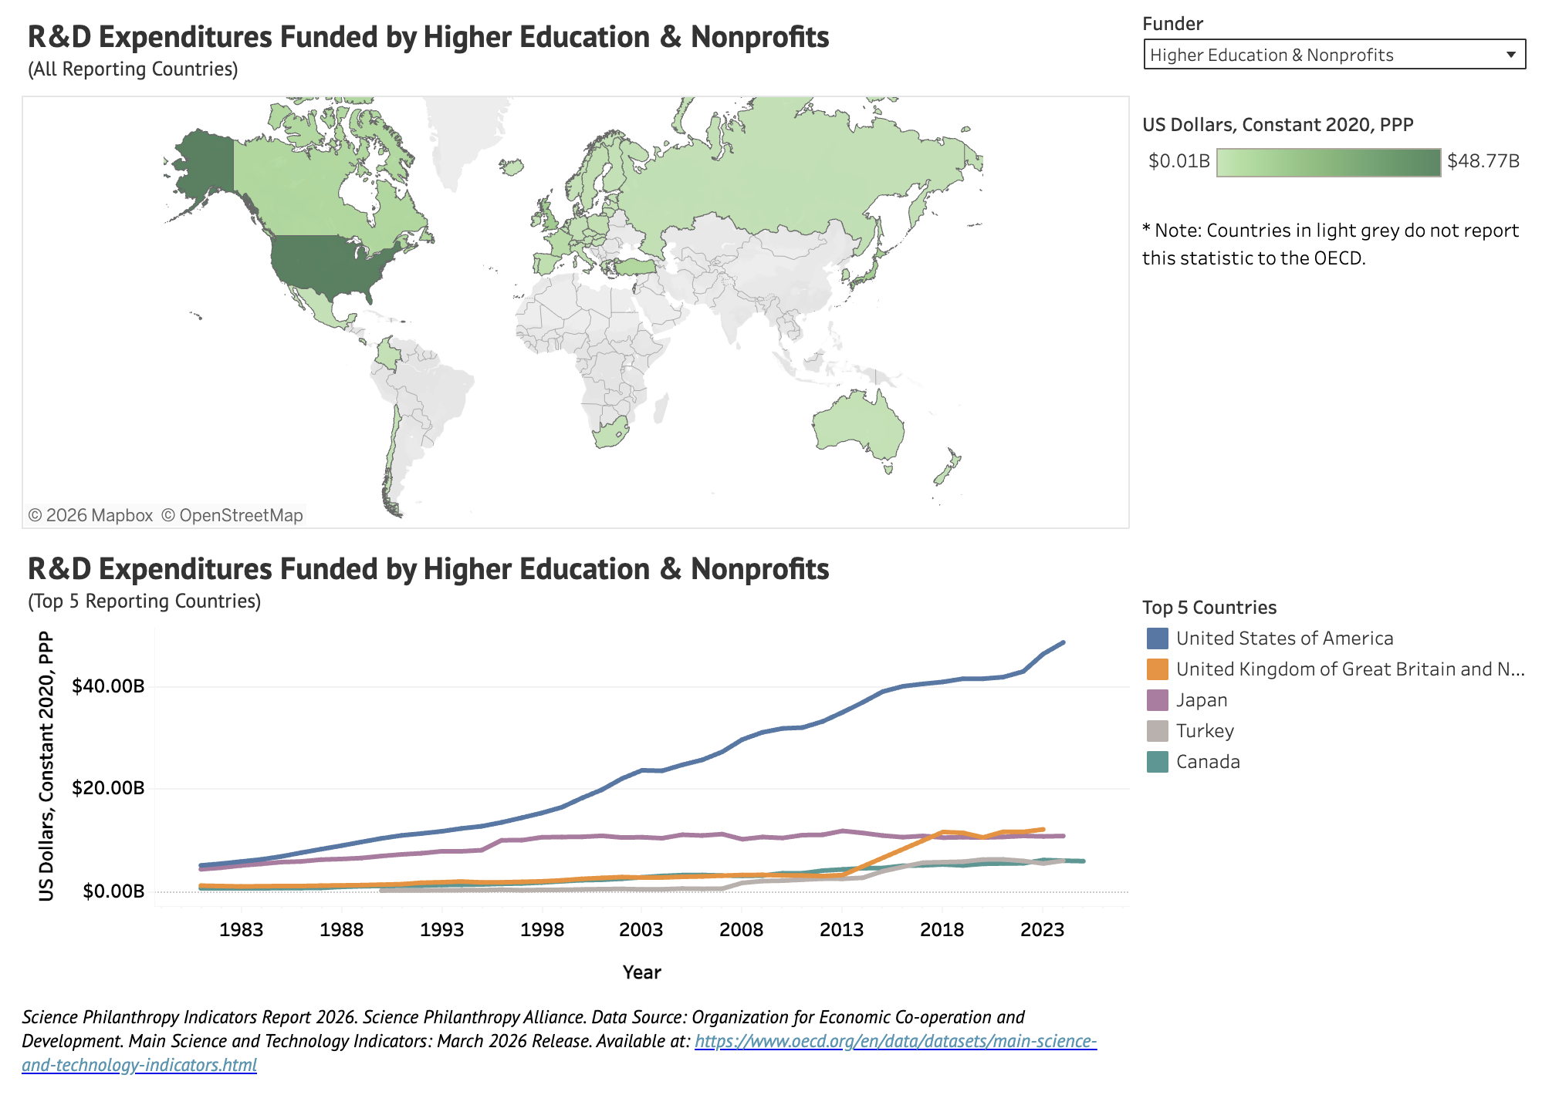

Slide 35
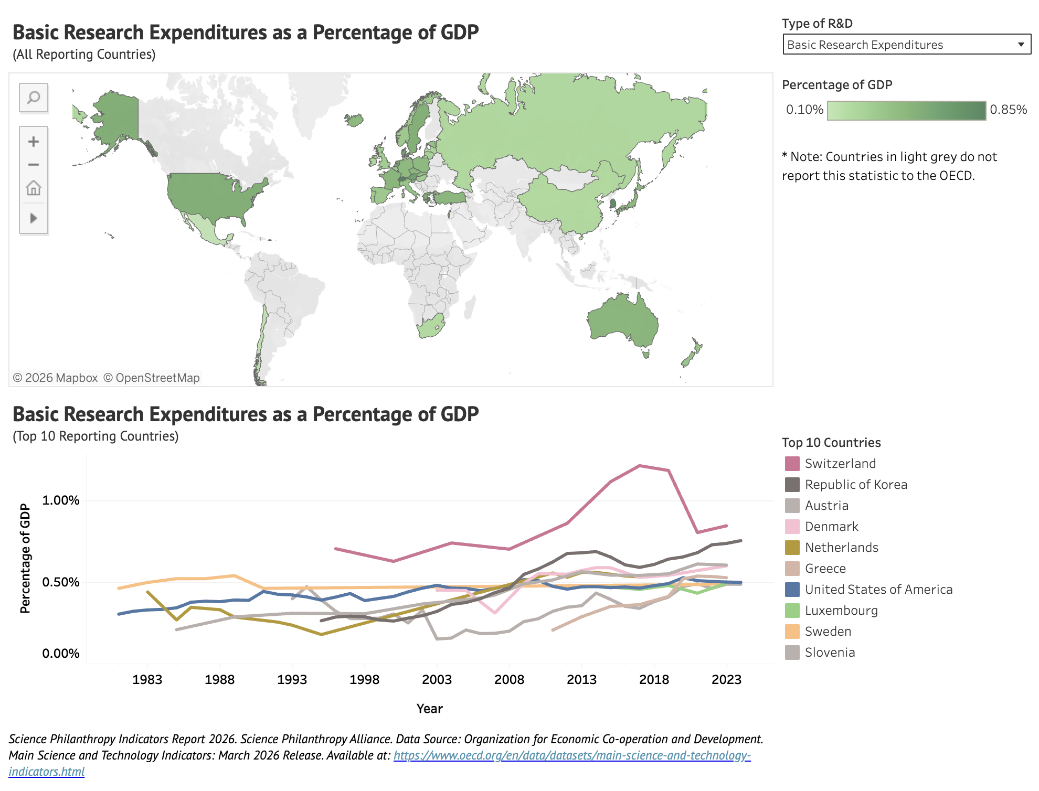

Slide 36
